Slide 1
Chapter 9-4
Distance Vector Protocols

Slide 2
RIP
RIP (Routing Information Protocol) is a dynamic routing protocol meaning that the routers periodically exchange routes.
RIP is classified as a distance vector protocol using router hop count as the metric. The hop count is the number of routers the packets go through to reach the destination network.
RIP permits a maximum of 15 hops to prevent routing loops. Routing loops occur when a router forwards the packets back to the router that sent them.

Slide 3
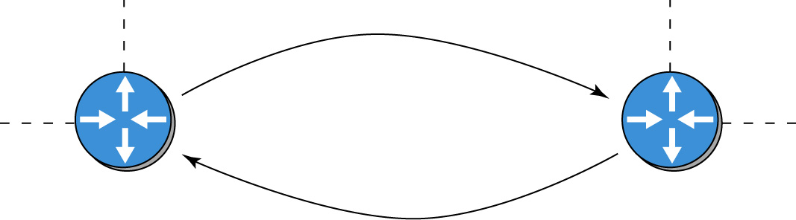
A
B
Routing loops occur when a router forwards the packets back to the router that sent them as shown.

Slide 4
RIP
RIP and other distance-vector routing protocols send the entire routing table to neighbor routers at regular time intervals.
Sometimes the routing tables can be quite large and the transfer of these tables can consume network bandwidth. This is of great concern in networks with limited bandwidth because the periodic exchange of the routing tables can lead to slow downs in data traffic.
The default time interval for RIP for exchanging routing tables is 30 seconds. This results in slow route convergence and if there are multiple routers sharing RIP routes, there will be even longer convergence time.

Slide 5
RIP Configuration
The procedures for configuring RIP and RIPv2 are discussed in section 9-5

Slide 6
Key Terms
Distance Vector Protocol
RIP Routing Information Protocol
Routing Loop

